Slide 1
Voice Soft Skills Training
Aligned to Voice QMF 2026 | Quality Team
Notes:
Welcome the group. Introduce yourself and the purpose: this session translates the Voice QMF 2026 scorecard - specifically the 40-point Soft Skills section - into practical habits agents can use on every call. Set expectations: interactive, not a lecture; agents will practice out loud, play two short games, run role-plays, and finish with a live Kahoot quiz.

Slide 2

Today's Session
Welcome and Why Voice Matters - 10 min
Soft Skills Cluster 1: Opening, Personalization, Tone & Professionalism + Say This/Not That drill - 20 min
Soft Skills Cluster 2: Active Listening, Empathy, Acknowledgement + Tone Twist Game - 25 min
Soft Skills Cluster 3: Customer Service Execution, Proactivity & Ownership, Closure Standards - 20 min
60-Second Explainer Drill - 10 min
Role-Play Practice - 20 min
Self-Assessment Checklist - 5 min
Kahoot Knowledge Check - 10 min
Action Plan and Q&A - 10 min
Notes:
RECOMMENDED DURATION: 2 hours 20 minutes (140 minutes) including one 10-minute break, best placed right after the Tone Twist Challenge game. (Agenda segments sum to 130 min + 10 min break = 140 min.) Lean option: if only 2 hours are available, cut Role-Play to 2 scenarios and trim the Kahoot round to 5 questions.

Slide 3
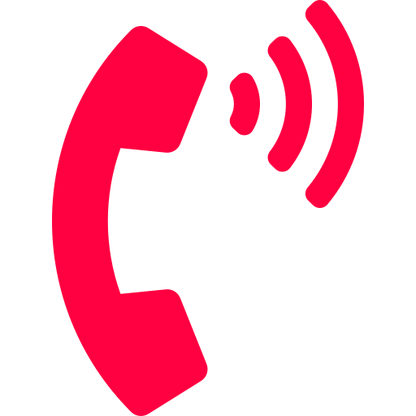
Why Voice Matters
01
Voice is the first impression - callers judge you in the first 5 seconds.
02
Tone carries more weight than the words themselves.
03
Dead air feels 3x longer on a call than in person - always narrate what you're doing.
REMEMBER
Your voice IS Air Arabia in that moment - no logo, no smile, no uniform, just you.
Notes:
Ask the group: "What's the first thing you notice about a stranger's voice on the phone?" Take 2-3 answers before moving into the Soft Skills block. This is a quick mindset-setter, not a deep dive.

Slide 4
Soft Skills
QMF 2026 - 40 of 100 Points
Notes:
This is the biggest scoring section on the Voice QMF 2026 - 40 of 100 points across 9 behaviors. We will go through them in three clusters of three, with a hands-on activity after each cluster.

Slide 5

Opening
5 of 40 points
PASS
Greet within 1-2 seconds. "Thank you for calling Air Arabia / FlyJinnah, this is [name], how can I help you?" Warm, confident tone.
FAIL
Greeting after 3+ seconds, missing company name/self-intro/offer to help, mumbling, robotic tone.
CRITICAL - AUTOMATIC FAIL
Rude or dismissive opening tone toward the passenger.
REMEMBER
The Answering Machine Test: if a robot could say it, it's wrong - never open a call with silence.
Notes:
ACTIVITY: Two volunteers greet live - group scores warmth 1-5 on fingers. There's no second chance at a first impression - the first 2 seconds set the tone for the whole call.

Slide 6

Personalization
4 of 40 points
PASS
Use the passenger's name from the system without asking again. Use it naturally 2-3 times, matching the system record.
FAIL
Asking for the name when visible, using the wrong name, using it once or never.
REMEMBER
The Golden Rule of 3: their name at hello, in the middle, and at goodbye - like the barista who remembers your order.
Notes:
ACTIVITY: Practice weaving a customer's name into 3 sentences - open, middle, close. If the name isn't in the system, ask once, politely, then use it consistently - watch for overuse.

Slide 7
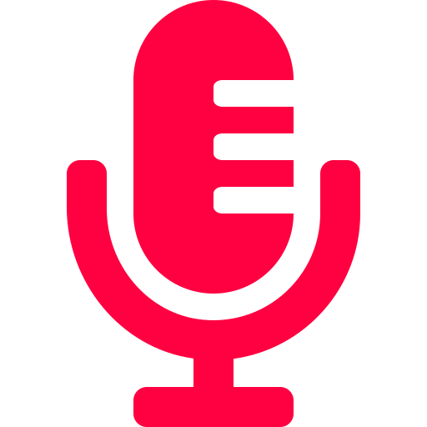
Tone & Professionalism
4 of 40 points
PASS
Welcoming, friendly, active, confident, warm, empathetic when needed - throughout the whole call.
FAIL
Monotonous, robotic, cold, disengaged, rushed, careless.
CRITICAL - AUTOMATIC FAIL
Rude, aggressive, dismissive, or disrespectful conduct.
REMEMBER
Smile Before You Speak: radio DJs record smiling on purpose because listeners can hear it - so can your passenger.
Notes:
ACTIVITY: Say This Not That drill and the Tone Twist Challenge game (up next) make this tangible - bridge straight into it.

Slide 8

Say This, Not That
USE: "Let me find out who can help you with this right away.“
USE: "Thank you for your patience - this will take about [X] minutes.“
USE: "Here's what I can do for you instead.“
USE: "I understand this is frustrating - let's sort it out together."
AVOID: "That's not my problem.“
AVOID: "You'll have to wait."
AVOID: "I can't do that."
AVOID: "Calm down, please."
Notes:
Read each AVOID line aloud in a flat/dismissive tone first, then read the USE INSTEAD line warmly - let the group hear the contrast. Ask agents to suggest one more phrase they catch themselves saying.

Slide 9

Active Listening
6 of 40 points - the highest-weighted soft skill
PASS
Fully focused, no interrupting, asks relevant probing questions, confirms understanding, avoids dead air.
FAIL
Interrupts, misunderstands or ignores needs, no clarifying questions, proceeds on assumptions.
REMEMBER
One Story, One Time: nobody should repeat themselves - like a doctor who already read your chart.
Notes:
ACTIVITY (Your Turn Now): Read a short complaint aloud - agent paraphrases it back in one sentence before offering a solution. Everything downstream depends on hearing the request correctly first.

Slide 10

Empathy
4 of 40 points
PASS
Genuine understanding of impact on the customer, natural (not scripted) empathy statement before the solution.
FAIL
Purely transactional when empathy is called for, ignores frustration, scripted/mismatched empathy line.
REMEMBER
Feel It Before You Fix It: if a friend's flight got cancelled, you'd say "that's awful" before offering solutions.
Notes:
ACTIVITY: Contrast a flat, recited empathy line against a warm, situation-specific one - read both aloud.

Slide 11

Acknowledgement
4 of 40 points
PASS
Verbally acknowledges the request or concern before proceeding, confirms purpose of contact before the next step.
FAIL
Proceeds without acknowledging the request, ignores key info already shared, jumps to unrelated questions.
REMEMBER
Echo, Then Act: like a pilot's read-back to air traffic control - repeat what you heard before you respond.
Notes:
HABIT: Echo back what you heard before acting - "So you'd like to move your flight to the 14th, let me check that."

Slide 12

GAME - Tone Twist Challenge (5 min)
GAME - 5 minutes
Notes:
Pick a sentence from today's call topics, e.g. "I'm sorry, but that fare is non-refundable." Agent reads it 3 times: annoyed, robotic, then warm. Group discusses which version a real customer would respond best to. Repeat with a second sentence - agent self-scores their warm delivery. Scoring: 1 point for each tone clearly distinguishable, 2 bonus points if the "warm" version sounds natural.

Slide 13

Customer Service Execution
4 of 40 points
PASS
Clear, complete communication. Correct hold - ask permission, give a reason, thank after. Professional data collection.
FAIL
Incorrect hold - no permission, reason, or thank-you. Abrupt data collection ("Give me your ID").
REMEMBER
Ask, Explain, Thank: like a doctor's receptionist who says "let me just check" instead of vanishing without a word.
Notes:
ACTIVITY: Role-play the 3-step hold habit as a pair until it's automatic.

Slide 14

Proactivity & Ownership
4 of 40 points
PASS
Takes full responsibility, drives toward resolution, doesn't wait for the customer to push, transfers with full context.
FAIL
Deflects responsibility, leaves the customer without next steps, unnecessary or repeated transfers.
REMEMBER
You Own It, End to End: a five-star concierge never says "that's not my department" - they solve it personally.
Notes:
KEY LINE: "Treat every interaction as an opportunity, not just a question to close."

Slide 15

Closure Standards
5 of 40 points - your last impression
PASS
Asks if further help is needed, thanks the customer including company name, proper closing statement, mentions survey.
FAIL
Ends abruptly, missing thank-you or company name, no mention of transfer, disconnects without closure.
REMEMBER
End on a High Note: it's the last scene of the movie - the part they actually remember.
Notes:
Closure is remembered as vividly as the opening - don't let a great call end on a flat note.

Slide 16

DRILL - The 60-Second Explainer (5 min)
DRILL - 5 minutes
Notes:
Pick a policy topic (baggage allowance, refund process, or rebooking) and start a 60-second timer. Explain it as if speaking to a first-time flyer. Group discusses: any jargon, filler words, or unclear steps? Repeat the explainer, aiming to trim time while keeping clarity. Scoring: full points for finishing under 60 seconds with zero jargon; deduct a point per jargon term.

Slide 17
Practice
Role-Play
Notes:
Coach plays the customer, agent responds live, then the group debriefs together. No scripts allowed.

Slide 18

Role-Play Practice
3 scenarios - 20 minutes
Notes:
The Delayed Flight: a passenger is upset about a 3-hour delay and missed connection. The Baggage Complaint: a customer's bag arrived damaged and they are raising their voice. The Fare Dispute: a customer insists they were charged incorrectly for extra baggage. Coach plays the caller for each scenario; a different agent responds live each time. Keep each role-play to 3-4 minutes, then debrief for 2-3 minutes. Debrief questions: What went well? Where did you feel stuck? What phrase would you change next time? Watch for: Empathy before solutioning, Active Listening, Ownership, and proper Closure.

Slide 19

Agent Self-Assessment Checklist
Opening - fast, warm greeting
Personalization - name used naturally, 2-3 times
Tone & Professionalism - warm and engaged throughout
Active Listening - no interrupting, no dead air
Empathy - genuine, situation-specific statement
Acknowledgement - request acknowledged before acting
Customer Service Execution - correct hold procedure
Proactivity & Ownership - drove call to resolution
Closure Standards - thanked customer, closed properly
Notes:
This checklist mirrors the 9 Soft Skills categories on the Voice QMF 2026 exactly - use it as a self-rating tool after listening back to a recorded call.

Slide 20
Knowledge Check
Kahoot
Notes:
Have the Kahoot game already created and the join PIN ready to display before this slide.

Slide 21

Let's Play - Quiz Time!
Notes:
SETUP (before the session): create a free quiz at kahoot.com, add the 8 questions below, and have the game PIN ready to project. Agents join on their own phones at kahoot.it. 1. A customer calls and there is silence for 5 seconds before you speak. What went wrong? -> Opening is too slow - greet within 1-2 seconds 2. The system shows the customer's name as "Fatima." How should you use it? -> Use it naturally 2-3 times through the call 3. Which of these is a BEHAVIOURAL CRITICAL (instant fail)? -> Rude or dismissive tone toward the passenger 4. Active Listening is worth how many points on the Soft Skills scorecard? -> 6 5. Which is the correct hold procedure? -> Ask permission, give a reason, thank them after 6. A customer is frustrated about a delay. What should you do BEFORE offering a solution? -> Acknowledge and show empathy first 7. What must you do before ending a call? -> Ask if there's anything else, thank them, close professionally 8. "Every interaction is an opportunity, not just a question to close" describes which QMF category? -> Proactivity & Ownership Keep it fast-paced and fun - this is an energiser and a knowledge check, not a formal exam.

Slide 22
Q&A
Thank you!
Notes:
Open the floor. Close by re-stating the 9 QMF Soft Skills categories are exactly what will be observed on their next evaluation.

